Slide 1
CHAPTER - 4 HEAT
CLASS :- VII
SUBJECT :- SCIENCE

Slide 2
1) Hot and cold :-
In our daily life we come across a number of objects. Some of them are hot and some of them are cold.
Eg :- Tea is hot and ice is cold.
Some objects are hotter than others and some are colder than others.
We often decide which object is hotter than the other by touching the objects.
We cannot always rely on our sense of touch to decide how hot or how cold an object is.
The hotness of an object is measured by its temperature.
Temperature :- is a measure of the degree of hotness of an object.
Temperature is measured by a device called thermometer.

Slide 3
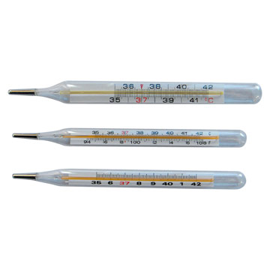
Clinical thermometers

Slide 4
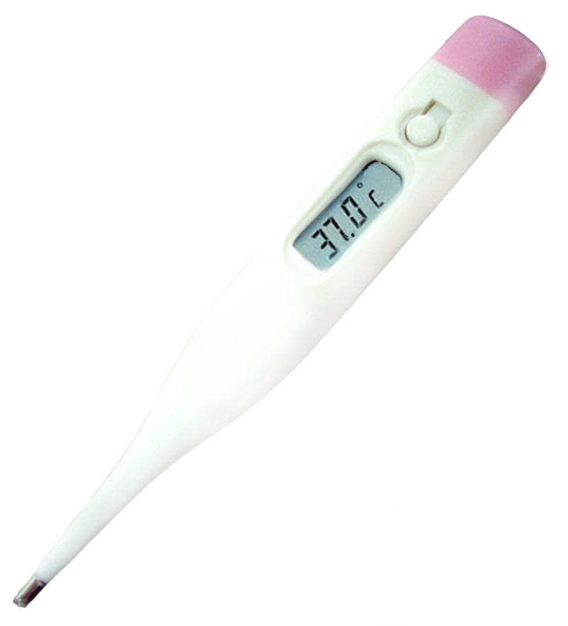
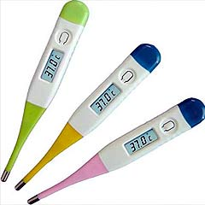
Digital thermometers

Slide 5
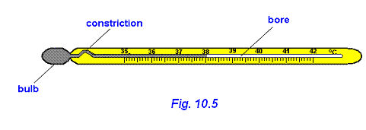
2) Measuring temperature :-
The thermometer that measures the temperature of our body is called clinical thermometer.
A clinical thermometer has a long narrow glass tube. It has a bulb at one end containing mercury. It has a scale called celsius scale marked in ⁰C (degree celsius). A clinical thermometer reads temperature from 35 ⁰C to 42 ⁰C.The clinical thermometer has a small kink near the bulb to prevent the mercury level from falling down.
The normal temperature of the human body is 37 ⁰C.
kink
kink
mercury
Clinical thermometer

Slide 6
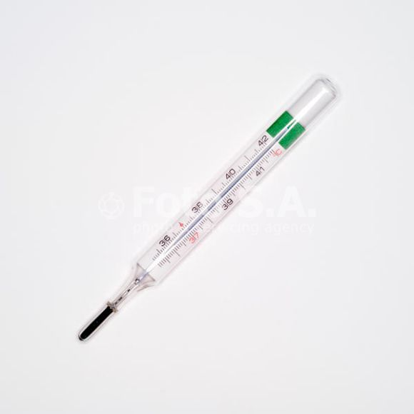
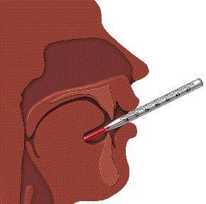
3) Reading a clinical thermometer :-
Wash the thermometer with an antiseptic solution. Hold it firmly and give it a few jerks to bring the level of mercury below 35 ⁰C. Then place the bulb of the thermometer under your tongue. After one minute take out the thermometer and note the reading. This will be your body temperature.

Slide 7
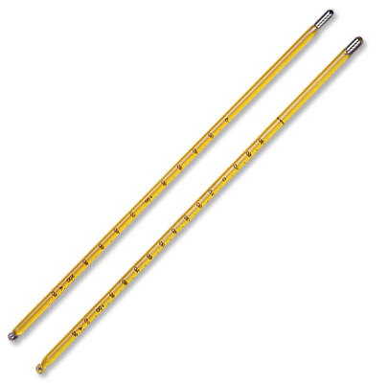
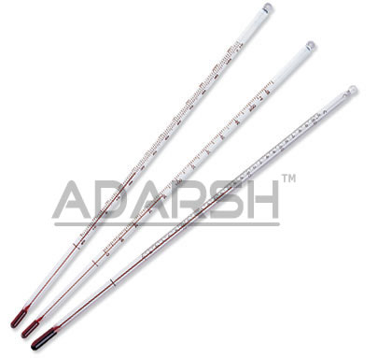
4) Laboratory thermometer :-
A laboratory thermometer has a long narrow glass tube. It has a bulb at one end containing mercury. It has a scale marked in ⁰C (degree celsius). The range of a laboratory thermometer is generally from - 10 ⁰C to 110 ⁰C.

Slide 8
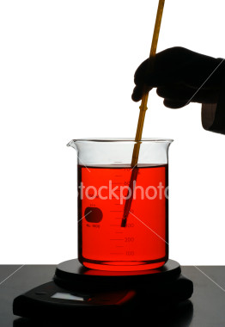
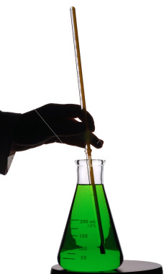
5) Measuring temperature with a laboratory thermometer :-
Take some tap water in a beaker. Dip the thermometer in the water so that the bulb of the thermometer does not touch the bottom or the sides of the beaker. Hold the thermometer vertically. The mercury level rises. Wait till the level of mercury becomes steady. Note the level of mercury. This will be the temperature of the water.

Slide 9
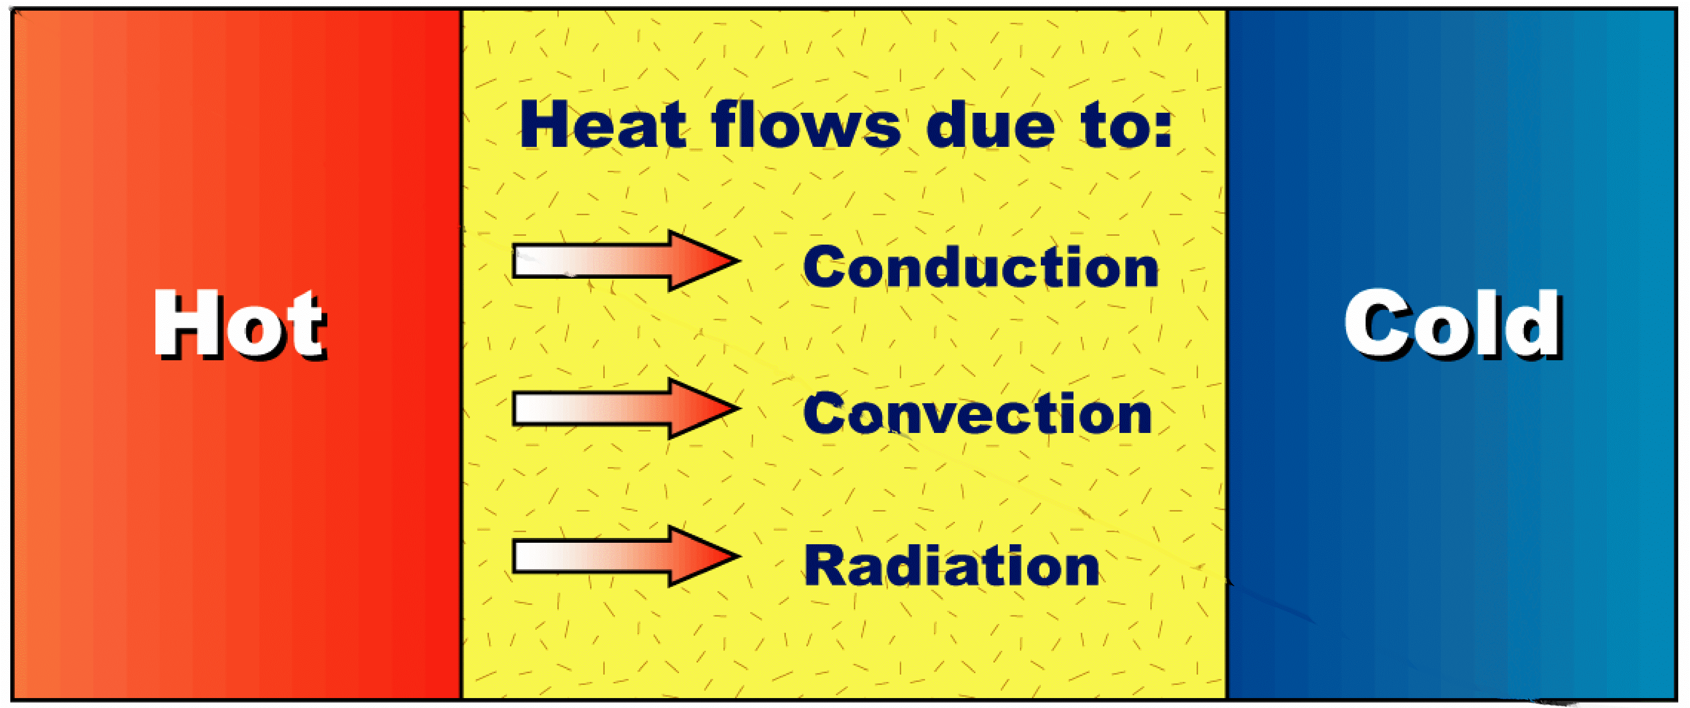
6) Transfer of heat :-
Heat flows from a body at a higher temperature to a body at a lower temperature. This is called transfer of heat.
Heat is transferred in three different ways. They are :-
i) Conduction
ii) Convection
iii) Radiation

Slide 10
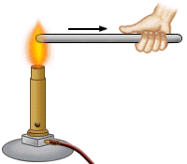
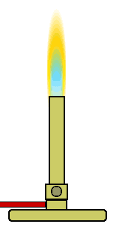
i) Conduction :-
Conduction is the process by which heat is transferred in solids from the hotter end to the colder end.
Activity :-
Take an iron or aluminium rod or strip. Fix a few wax pieces on at equal distances. Clamp the rod to a stand. Heat the other end of the rod. The wax pieces begin to melt and fall down from the heated end. This shows that heat is transferred from the hotter end to the colder end by conduction.
Heat
Wax pieces
Conduction of heat

Slide 11
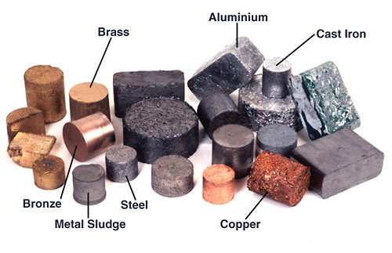
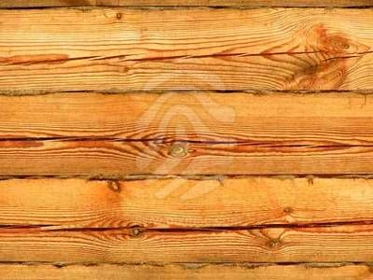
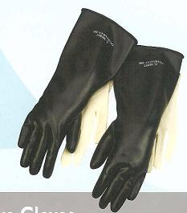
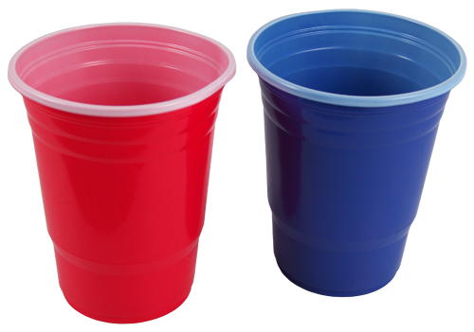
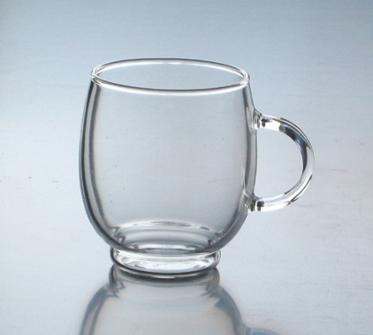
Conductors and insulators :-
Conductors :- are materials which allow heat to pass through them easily.
Eg :- iron, aluminium, copper etc.
Insulators :- are materials which do not allow heat to pass through them easily.
Eg :- wood, plastic, glass, rubber, air, water etc.

Slide 12
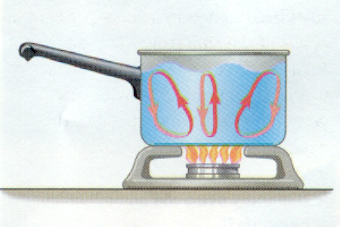
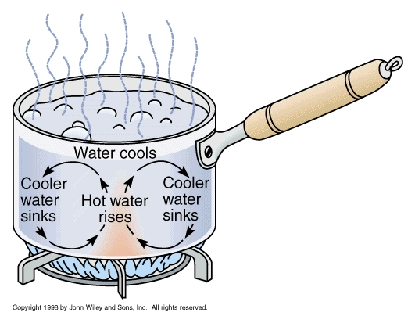
ii) Convection :-
Convection is the process by which heat is transferred in liquids and gases from the hotter part to the colder part.
Activity :- Take some water in a round bottom flask. Keep it on a tripod stand. Put a crystal of potassium permanganate in it. Heat it with a burner. The water at the bottom becomes hot and rises up and cold water from the top moves down. This water becomes hot and rises up and cold water from the top moves down and the process continues till all the water gets heated. This shows that heat is transferred by convection.

Slide 13
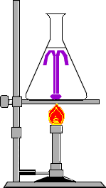

Slide 14
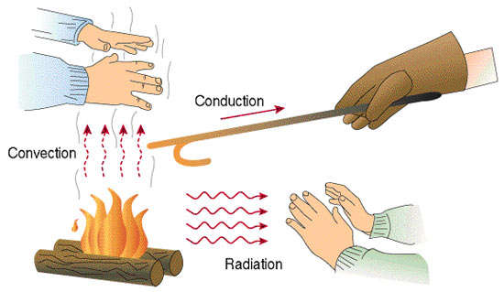
Convection in air :-
The air near the heat source gets heated and rise up. The air from the sides move in to take its place. In this way the air gets heated.
If you keep one hand above a flame and one hand on the side of the flame, the hand at the top feels hot because the air above is heated by convection. The hand at the side does not feel as hot because there is no convection.
No convection

Slide 15
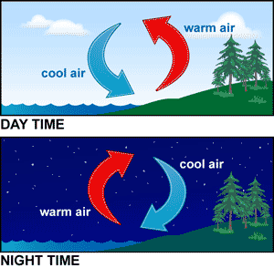
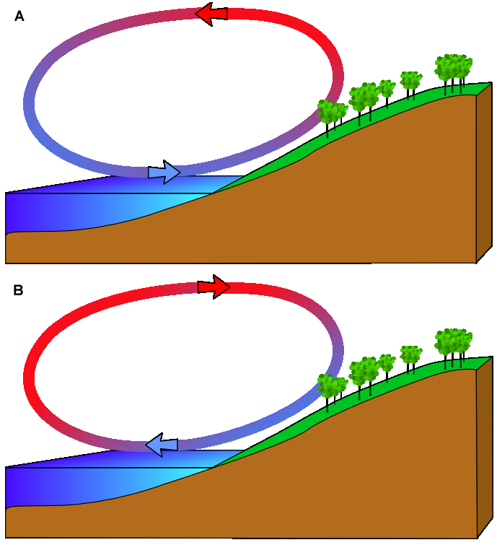
Sea breeze and land breeze :-
i) Sea breeze :-
During the day the land gets heated faster than the sea. So the air above the land gets heated becomes hotter and rises up and cool air from the sea moves towards the land. This is called sea breeze.
ii) Land breeze :-
During the night sea cools down slowly than the land. So the hot air above the sea rises up and cool air from the land moves towards the sea. This called land breeze.
Sea breeze
Land breeze

Slide 16
Sea breeze
Land breeze

Slide 17
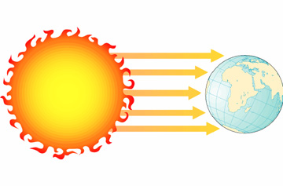
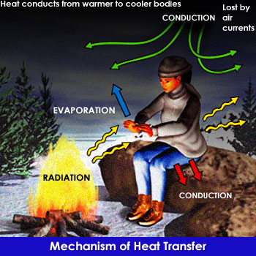
iii) Radiation :-
Radiation is the process by which heat is transferred from one place to another without the help of any medium.
Eg :- The heat from the sun reaches the earth by radiation.
When we sit near a fire we feel warm due to the heat
radiated by the fire.
All hot bodies radiate heat.

Slide 18
7a) Dark coloured surfaces absorb more heat than light coloured srfaces :-
Take two tin cans of the same size. Paint the outer surface of one black and the other white. Pour equal amounts of water in each and leave them in sunlight for about one hour. Measure the temperature of water in both the cans. The water in the black can is warmer than the water in the white can.
b) Dark coloured surfaces radiate more heat than
light coloured surfaces :-
Take two tin cans of the same size. Paint the outer surface of one black and the other white. Pour equal amounts of hot water of the same temperature (say 60⁰C). Leave them in a room or shade for 10 to 15 minutes. Measure the temperature of water in both the cans. The water in the black can is cooler than the water in the white can.

Slide 19
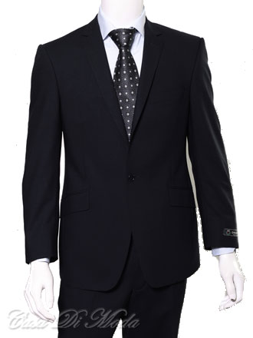
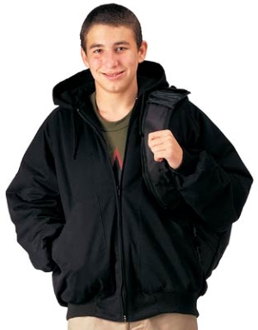
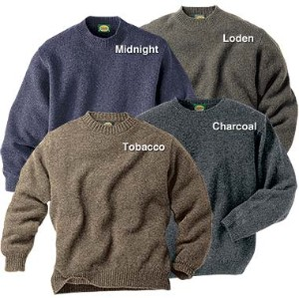
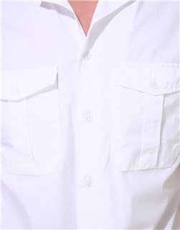
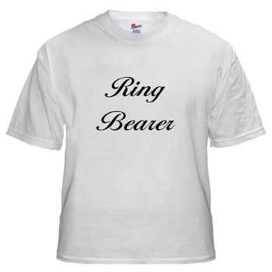
8) Kinds of cloth we wear in summer and winter :-
Dark coloured surfaces absorb more heat than light coloured surfaces. Dark coloured surfaces radiate more heat than light coloured surfaces.
We wear dark coloured clothes in winter because it absorbs more heat and keep us warm.
We wear light coloured clothes in summer because it reflects most of the heat and keeps us cool.
We wear woolen clothes in winter because wool is a poor conductor of heat and the air in between the wool fibres prevents loss of heat from our body. So we feel warm.

Slide 20
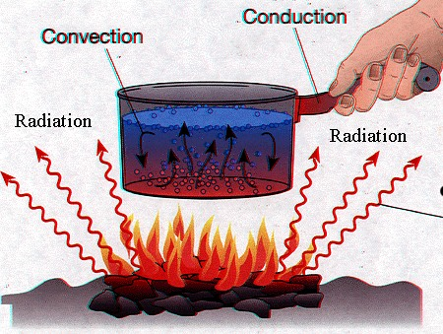

Slide 21
