Slide 1
CHAPTER - 5 ACIDS, BASES AND SALTS
CLASS :- VII
SUBJECT :- SCIENCE

Slide 2
1) Tastes of some common edible substances :-
Edible substances have different tastes. Some have sour taste, some have bitter taste, some have sweet taste and some have salty taste.
Sl.No. | Substance | Taste
1 | Lemon juice | Sour
2 | Orange juice | Sour/Sweet
3 | Vinegar | Sour
4 | Curd | Sour
5 | Tamarind | Sour
6 | Sugar | Sweet
7 | Common salt | Salty
8 | Amla | Sour
9 | Baking soda | Bitter
10 | Grapes | Sour/Sweet
11 | Unripe mango | Sour
12 | Glucose | Sweet

Slide 3
2) Acids :-
Acids are substances which have sour taste. These substances are acidic in nature.
Sl.No. | Substance | Name of acid
1 | Vinegar | Acetic acid
2 | Ant’s sting | Formic acid
3 | Citrus fruits like lemon, orange etc. | Citric acid
4 | Curd | Lactic acid
5 | Spinach | Oxalic acid
6 | Amla | Ascorbic acid
7 | Tamarind, grapes, unripe mangoes etc. | Tartaric acid

Slide 4
3) Bases :-
Bases are substances which have bitter taste and have a soapy touch. These substances are basic in nature.
Sl.No. | Substance | Name of base
1 | Lime water | Calcium hydroxide
2 | Window cleaner | Ammonium hydroxide
3 | Soap | Sodium hydroxide Potassium hydroxide
4 | Milk of magnesia | Magnesium hydroxide

Slide 5
4) Neutral substances :-
Substances which are neither acidic nor basic are
called neutral substances.
Eg:- sugar solution, salt solution, distilled water etc.
5) Indicators :-
Substances which change their colour in acidic and
basic solutions are called indicators.
Eg :- Litmus, Turmeric, China rose petals are some
naturally occuring indicators.

Slide 6
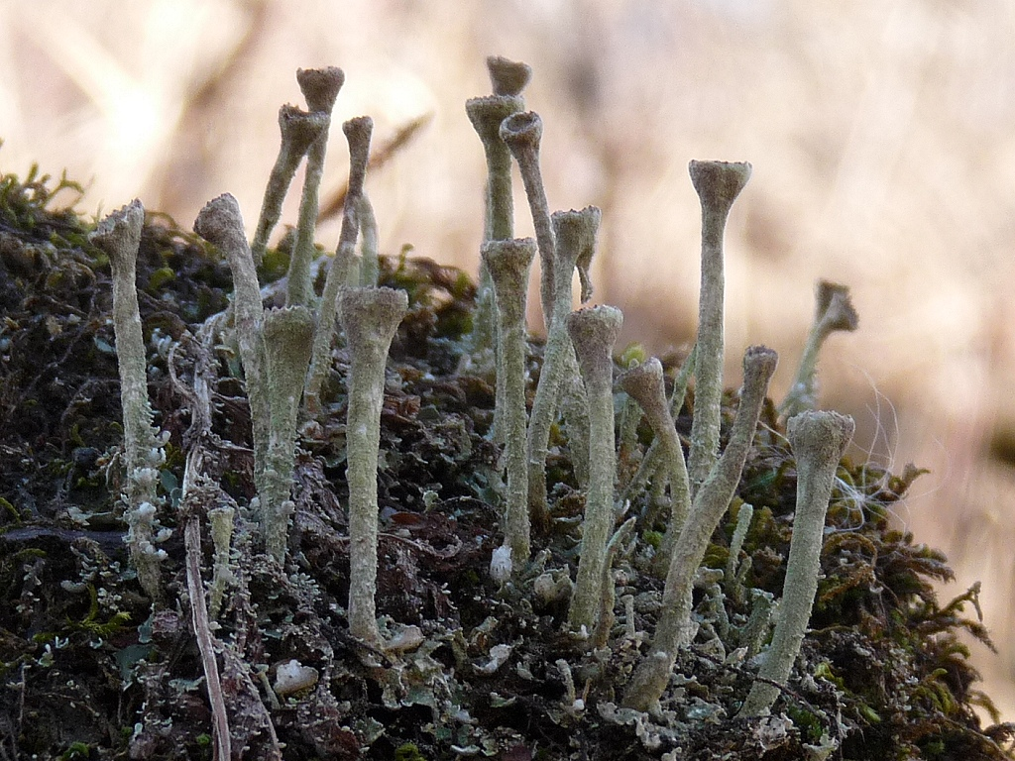
6) Natural indicators :-
a) Litmus as indicator :-
Litmus is a natural indicator obtained from lichens. It is available in the form of solution as blue litmus solution and red litmus solution or as strips of paper as blue litmus paper and red litmus solution.
In distilled water its colour is purple. In acidic solution it turns red and in basic solution it turns blue.

Slide 7
Effect of litmus paper on different solutions :-
Sl.No. | Test solution | Effect on blue litmus paper | Effect on red litmus paper | Inference
1 | Tap water
2 | Detergent solution
3 | Aerated drink
4 | Soap solution
5 | Shampoo
6 | Common salt solution
7 | Sugar solution
8 | Vinegar
9 | Baking soda solution
10 | Milk of magnesia
11 | Washing soda solution
12 | Lime water

Slide 8
b) Turmeric as indicator :-
Turmeric is a natural indicator obtained from turmeric. It can be used as turmeric solution or as turmeric paper. In acidic solution it turns and in basic solution it turns
Effect of turmeric solution on different solutions :-
Sl.No. | Test solution | Effect on turmeric solution | Remarks
1 | Lemon juice
2 | Orange juice
3 | Vinegar
4 | Milk of magnesia
5 | Baking soda
6 | Lime water
7 | Sugar solution
8 | Common salt solution

Slide 9
c) China rose as indicator :-
China rose is a natural indicator obtained from the petals of china rose flower. It is used as china rose solution. In acidic solution it turns dark pink (magenta) and in basic solution it turns green.
Effect of china rose solution on different solutions :-
Sl.No. | Test solution | Effect on china rose solution | Remarks
1 | Shampoo
2 | Lemon juice
3 | Soda water
4 | Baking soda
5 | Vinegar
6 | Sugar solution
7 | Common salt solution

Slide 10
d) Effect of acids and bases on natural indicators :-
Sl. No. | Name of Acid / Base | Effect on litmus paper | Effect on turmeric solution | Effect on china rose solution
1 | Dilute hydrochloric acid
2 | Dilute sulphuric acid
3 | Dilute nitric acid
4 | Dilute acetic acid
5 | Dilute sodium hydroxide
6 | Dilute ammonium hydroxide
7 | Dilute calcium hydroxide

Slide 11
7) Neutralisation :-
The reaction between an acid and a base is called neutralisation.
In a neutralisation reaction salt and water are formed.
Process of neutralisation :-
Take some dilute hydrochloric acid in a test tube. Add
2 – 3 drops of phenolphthalein to it. The solution will be
colourless. Add dilute sodium hydroxide solution to it drop
by drop and stir it. Continue adding sodium hydroxide drop
by drop till the solution becomes pink in colour.
When an acidic solution is mixed with a suitable amount of a basic solution, it becomes a neutral solution.

Slide 12
8) Salts :-
Salts are substances formed by the reaction between acids and bases.
Acid + Base Salt + Water
Eg :- Hydrochloric acid reacts with sodium hydroxide to form Sodium chloride and water.
Hydrochloric + Sodium Sodium + Water
acid hydroxide chloride
(Acid) (Base) (Salt)

Slide 13
8) Neutralisation in everyday life :-
i) Indigestion :- If the stomach produces too much hydrochloric acid, it causes indigestion. It can be neutralised by taking an antacid like Milk of magnesia (Magnesium hydroxide) which is basic.
ii) Ant sting :- When an ant bites, it injects formic acid. It can be neutralised by applying baking soda or calamine which are basic.
iii) Soil treatment :- Plants do not grow well if the soil is too acidic or too basic. If the soil is acidic it can be neutralised by adding quick lime (Calcium oxide) or slaked lime (Calcium hydroxide) which are basic. If the soil is basic it can be neutralised by adding organic matter which releases acids.
iv) Factory wastes :- Factory wastes which are sent into water bodies contain acids which can kill fishes and other organisms. It can be neutralised by adding basic substances.

